Slide 1
Introduction to Quantum Computing Systems
Swamit Tannu
Notes:
Zoom out
What is computing
Do you know
Error Correction?
Quantum computing

Slide 2
Plan for todays lecture
Context
Limits to existing computing paradigm
What is Quantum Computing?
What can we engineers do?

Slide 3
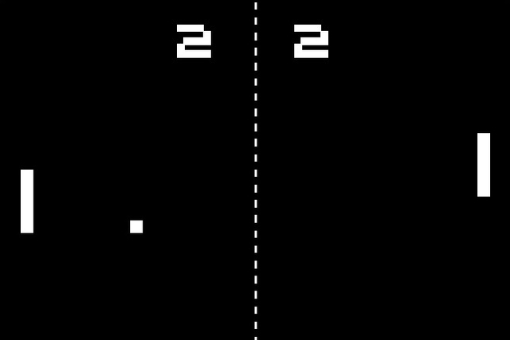
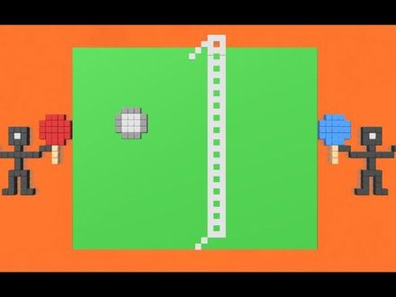

Computing is Transformation

Slide 4
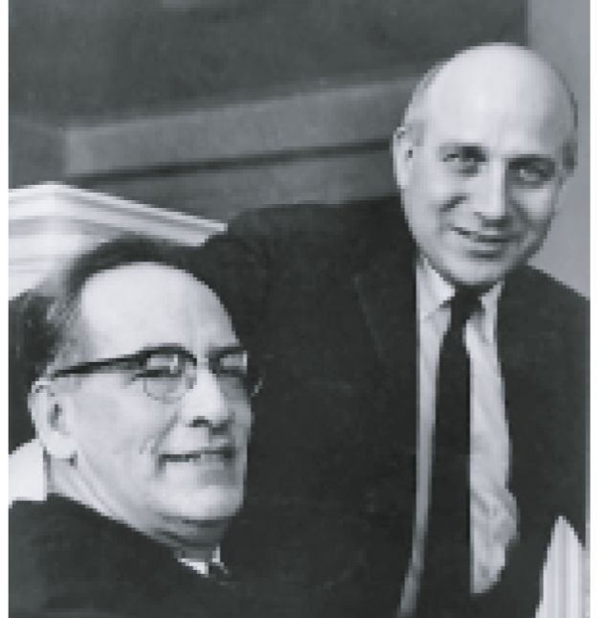

At the Beginning of Computer Engineering
Left: J. William Mauchly
Right: J. Presper Eckert
John Von-Neumann

Slide 5
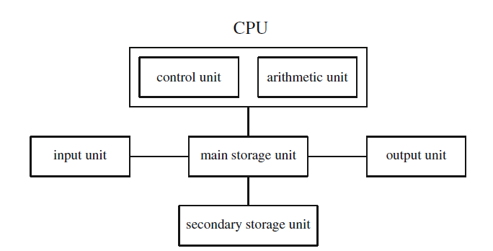
Von-Neumann Architecture

Slide 6
Computing Stack
Problem
Algorithms
PL & Compilers
Architecture
Circuits
Devices/Technology
Electrons

Slide 7
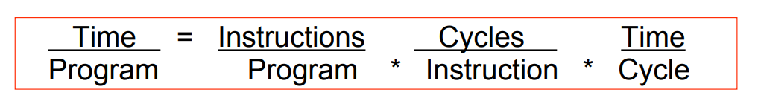
Iron Law for Performance
Customers
OS
Architect
Designer

Slide 8
Architectural Innovations in last 30 years
Better functional units – Adders, multipliers, shifters, pipelined architectures
Front-end ideas – feed the daemon, i-cache, Branch Predictors, Trace-caches
Out of Order – Find more ILP, ROB, Wide issue machines
Reduce Memory Latency -- Data Caches, LD-ST Ques
From single thread to multi-thread – ILP to task-level parallelism, SMT, GPU

Slide 9
Moore’s Law
Technology Scaling → 2x transistors every ~2 years

Slide 10
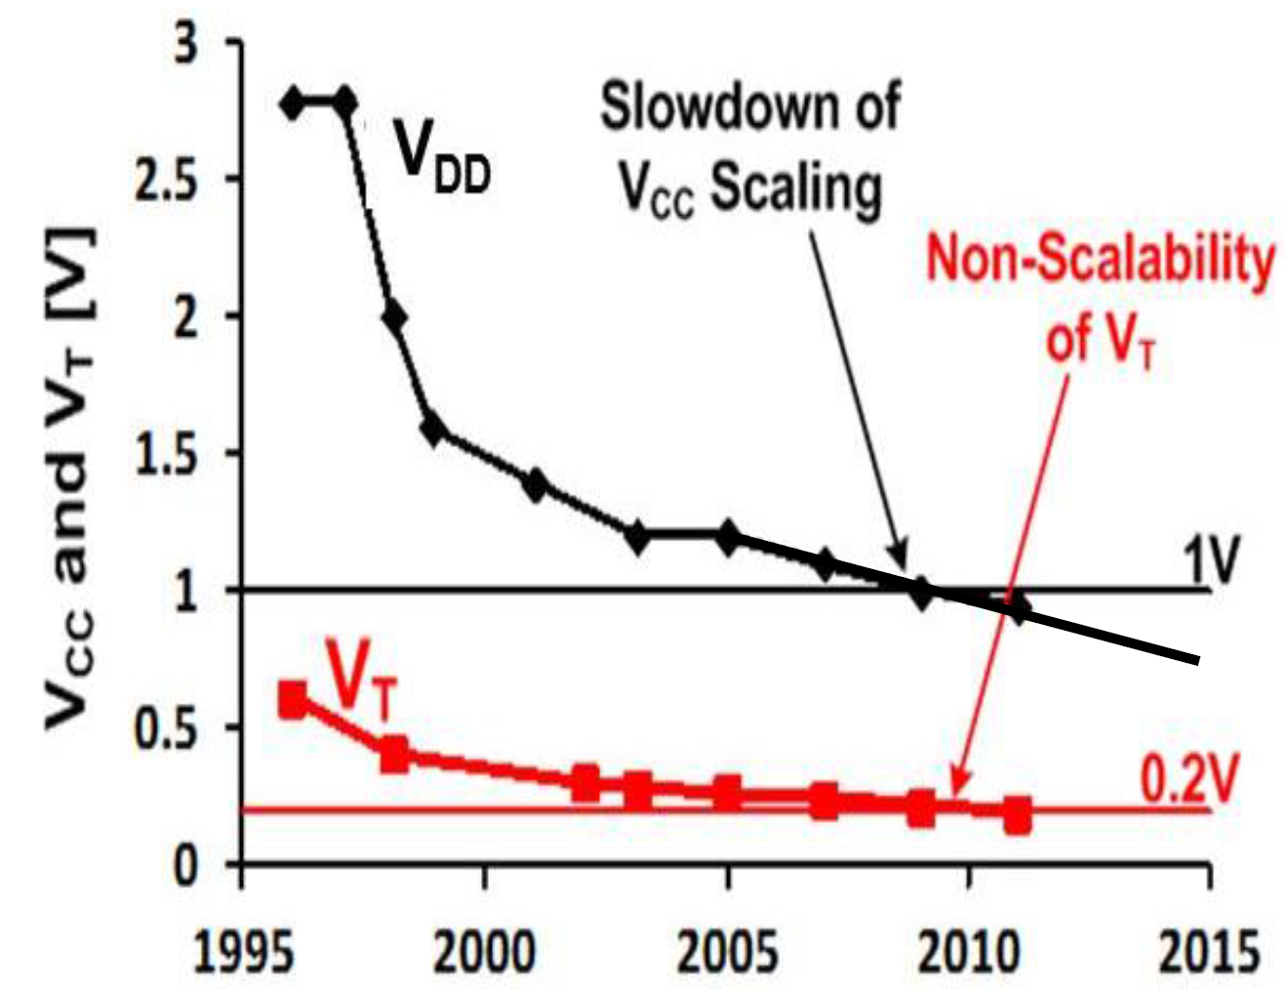
Limited Voltage Scaling

Slide 11
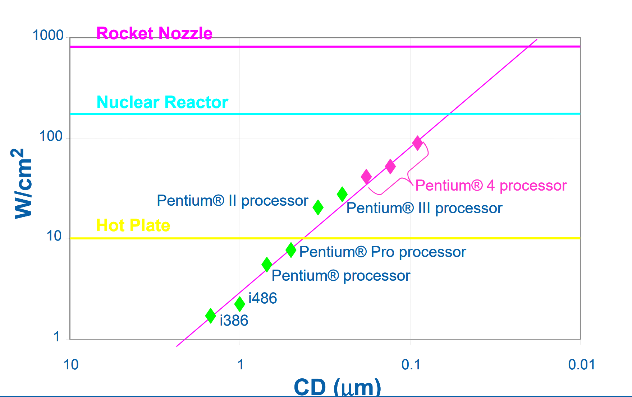
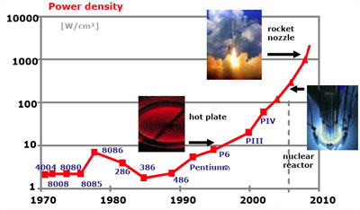
Thermal Challenges

Slide 12
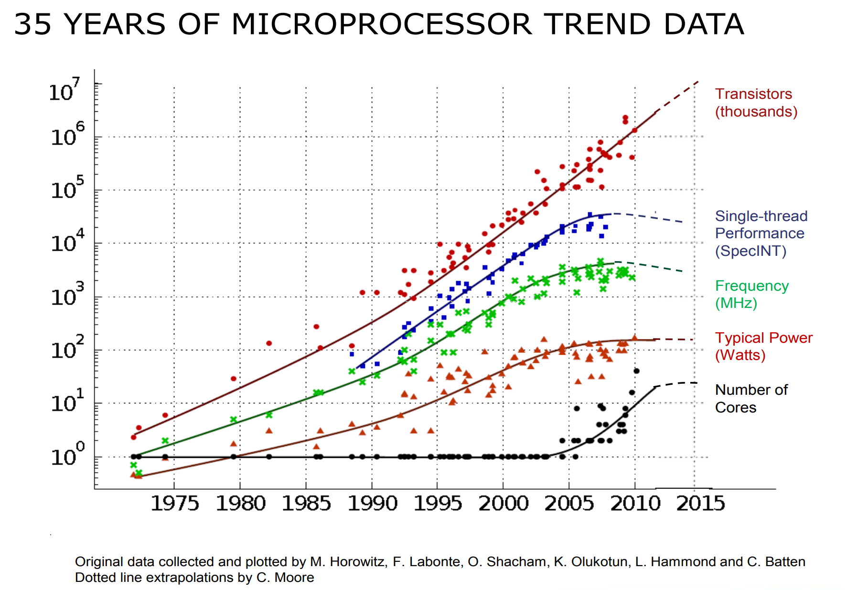

Slide 13
Scaling Improves Memory and Compute Capacity
cell
cell
Technology Scaling
cell
cell
DRAM Chip
Courtesy: Prashant Nair

Slide 14
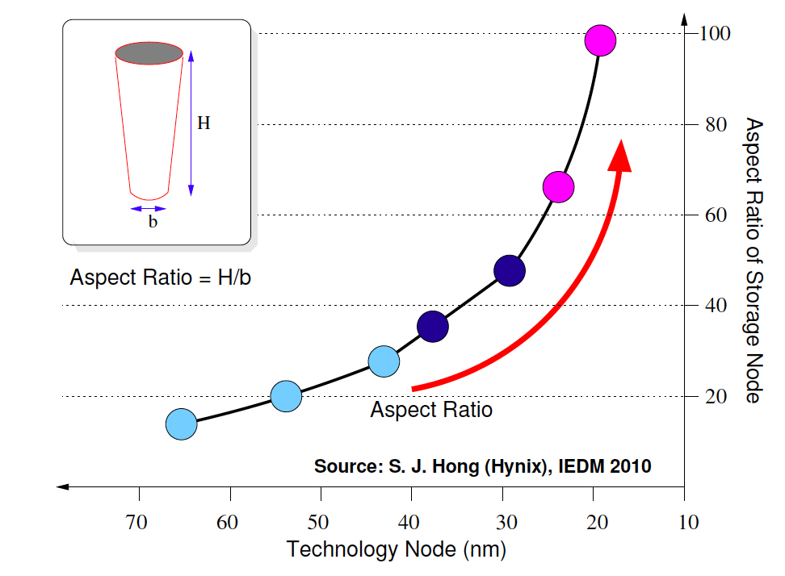
Scaling Deteriorates Reliability
DRAM Chip
Cell
Courtesy: Prashant Nair

Slide 15
Scaling Deteriorates Reliability
DRAM Chip
Courtesy: Prashant Nair

Slide 16
Scaling Deteriorates Reliability
DRAM Chip
✖
✖
✖
✖
Courtesy: Prashant Nair
Notes:
Redudancy and Error Correction

Slide 17
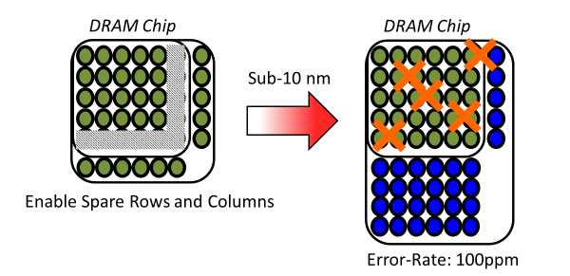
Sparing faulty cells in DRAM
Courtesy: Prashant Nair
Notes:
Redudancy and Error Correction

Slide 18
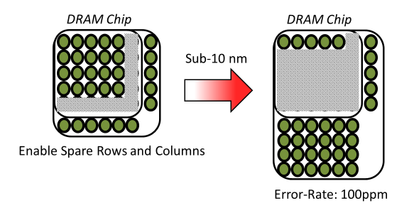
Sparing faulty cells in DRAM
Courtesy: Prashant Nair
Notes:
Redudancy and Error Correction

Slide 19
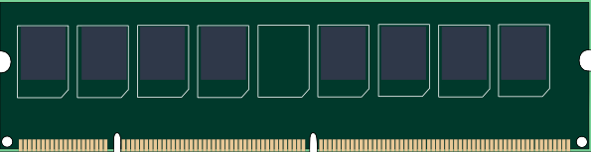
Using Error Correction to fight faulty cells in DRAM
Single Error Correct Double Error Detect (SECDED)
Data Chips
ECC Chip
Courtesy: Prashant Nair
Notes:
Redudancy and Error Correction

Slide 20
Using Error Correction to fight faulty cells in DRAM
Single Error Correct Double Error Detect (SECDED)
✖
✖
ECC Chip
Corrects single-bit fault in each word (8 Bytes)
For 8GB DIMM ➔ 1 Billion words
Courtesy: Prashant Nair
20
Notes:
Redudancy and Error Correction

Slide 21
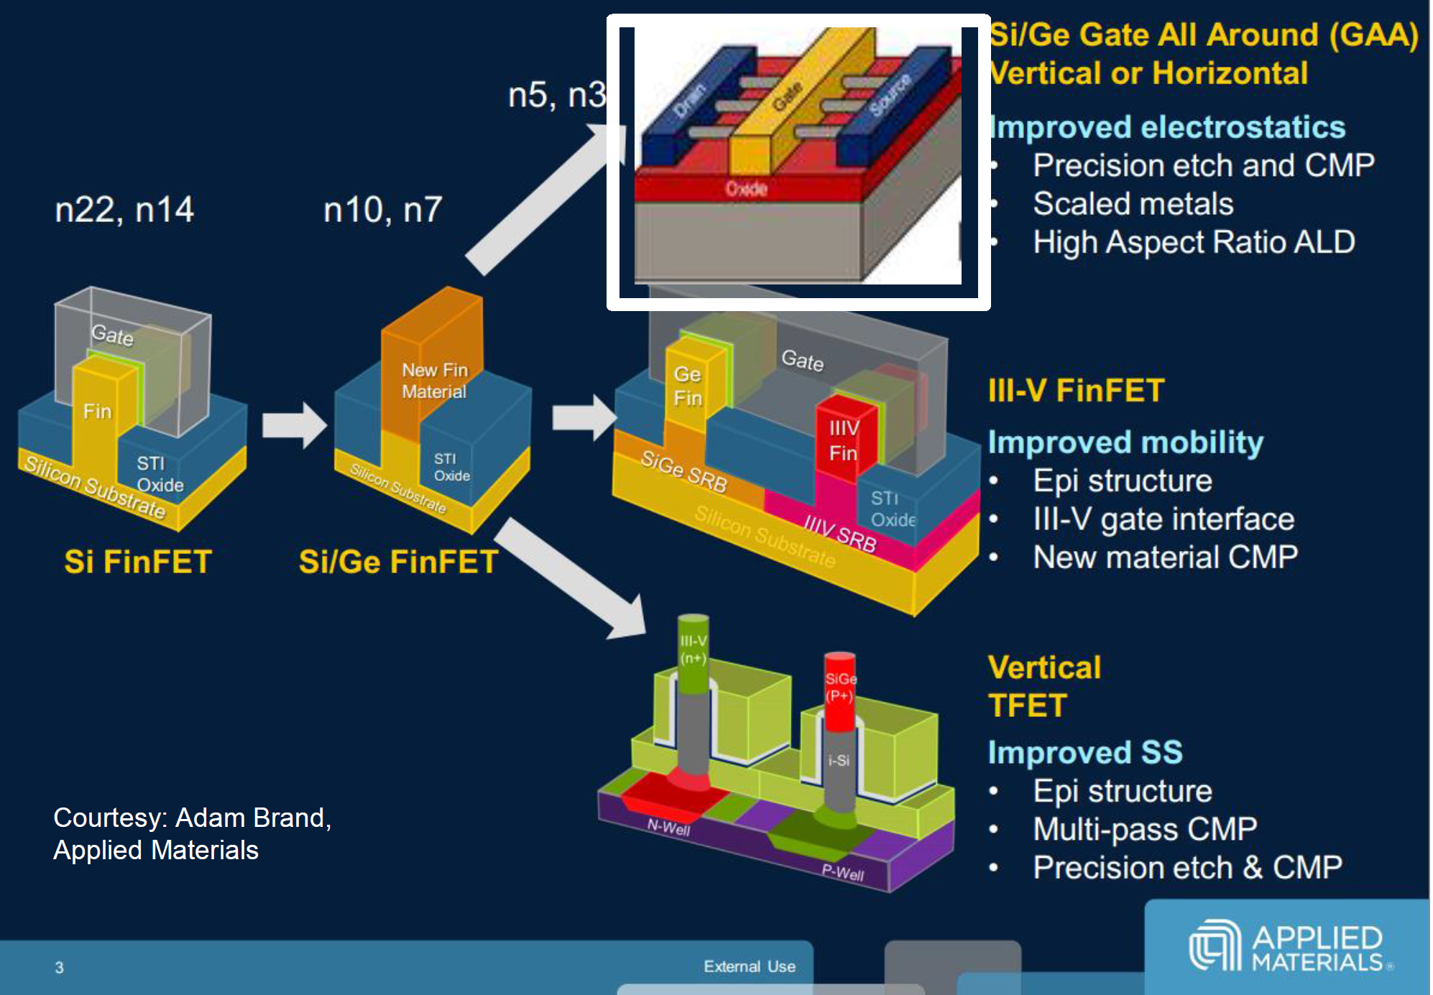
There is Path Towards 3nm Transistors

Slide 23
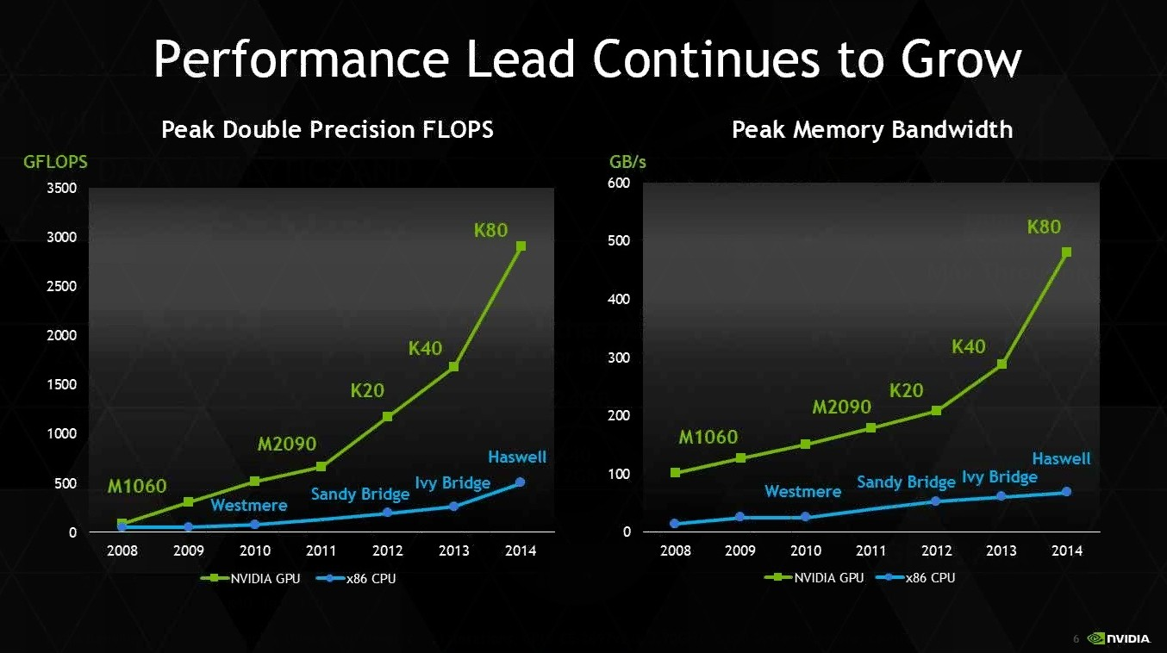
General Purpose Vs Special Purpose

Slide 24
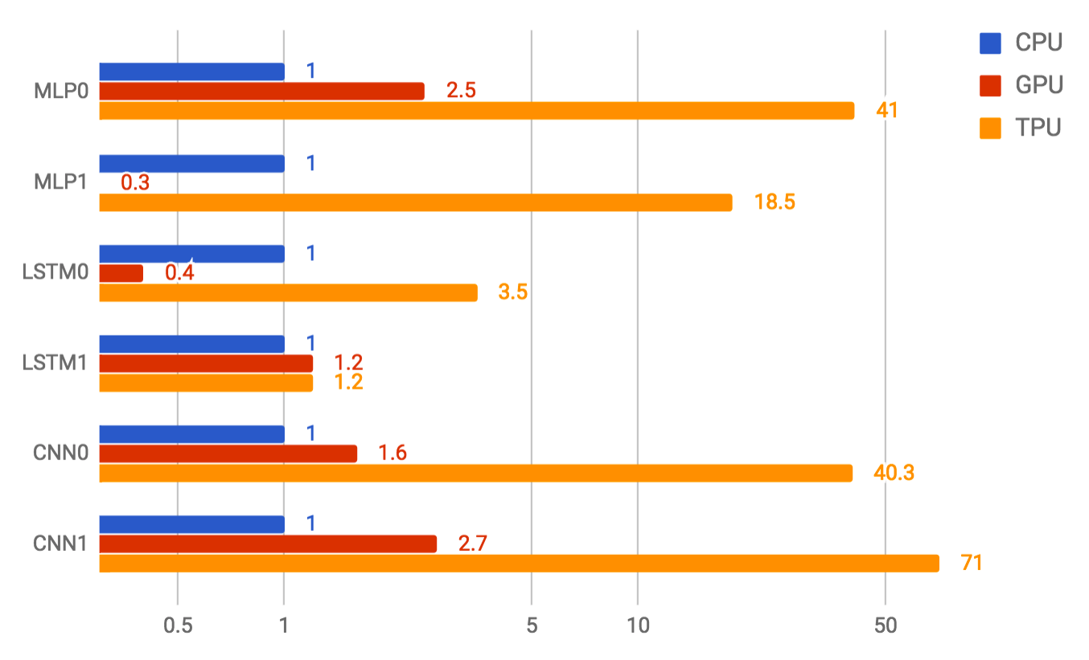
Rise of Domain Specific Accelerators

Slide 25
What’s Next?
Problem
Algorithms
PL & Compilers
Architecture
Circuits
Devices/Technology
Electrons

Slide 26
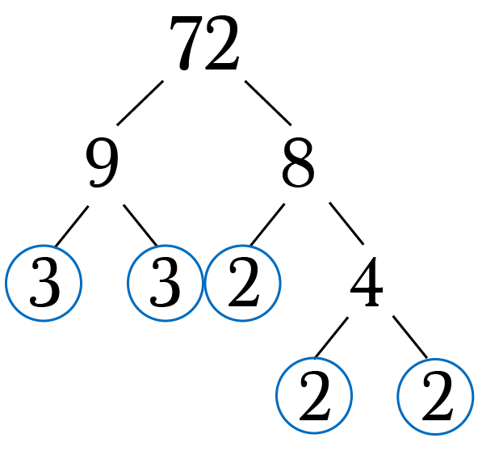
Why Build Quantum Computers?
Can solve fundamentally hard problems
Prime Factorization
100+ Years
Classical Computer
Execution Time
Problem Size
On existing computers, time to solve class of problems grow exponentially with problem size
Notes:
Quantum computers promise solutions to problems that are extremely hard to solve on a conventional computer.

Slide 27
Potential of Quantum Computers
Factoring a 2048-bit number
100+ years & Consume all energy of earth
Quantum computer can factor 2048-bit number in about 27 hours
(Ref: A. G. Fowler: arxiv.org/abs/1208.0928)

Slide 28
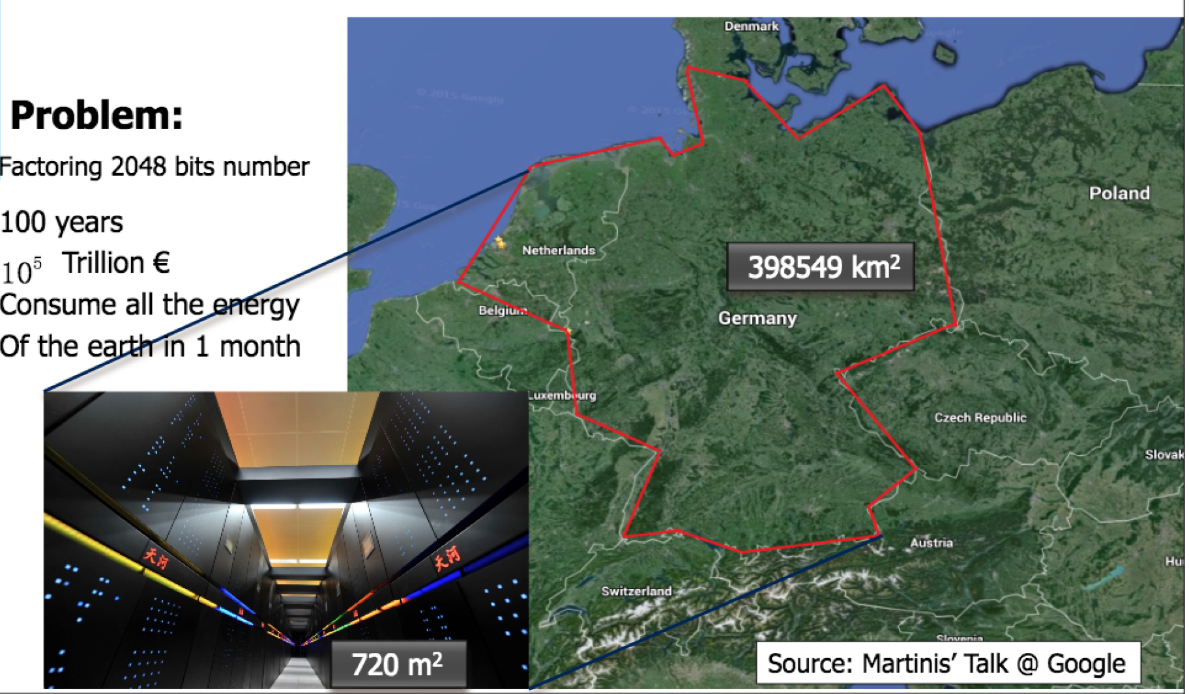
Potential of Quantum Computers
Factoring a 2048-bit number
100+ years
Consume all energy of earth
Quantum Computer
Shor’s factoring Algorithm
26.7 hours
A. G. Fowler: arxiv.org/abs/1208.0928

Slide 29


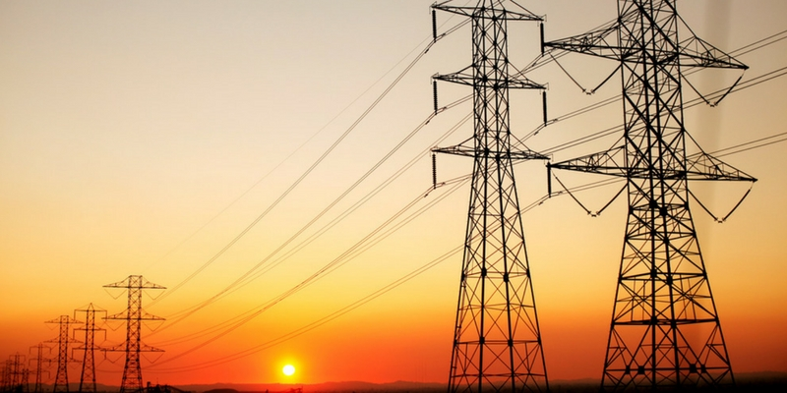
Potential of Quantum Computers
Quantum computers provide massive speedup for problems in chemistry, material science, and machine learning
100+ Years
Classical Computer
Execution Time
Quantum
Computer
Days
Efficient batteries
Efficient fertilizers
Zero-loss electric-grids
Problem Size
Quantum Computers enable solutions to important problems
Notes:
Why build quantum computers? So Quantum computing promise that we can solve problems which are unsolvable with todays computers, problems like molecular simulations
So how do quantum computer get this speedup? – So quantum computers leverage the properties of quantum bits to run extremely efficient quantum algorithms

Slide 30
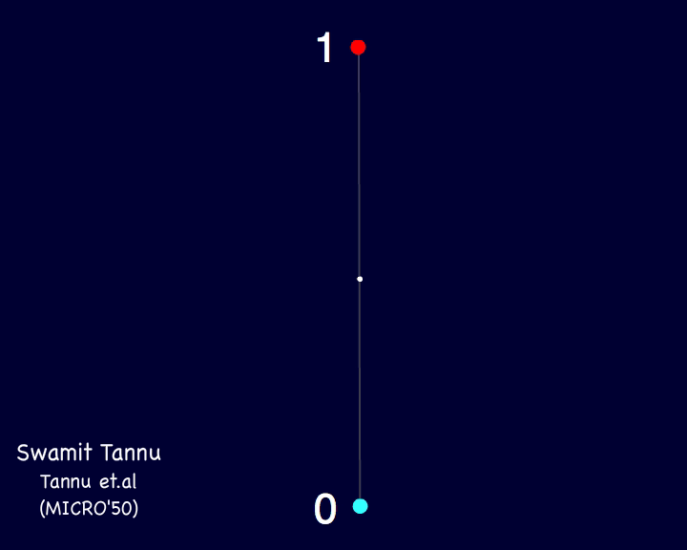
Quantum Bits
State of a Classical Bit
→ 1 or 0 two points on sphere
State of a Quantum Bit
Any point on the sphere
Quantum Bit
Classical Bit
Quantum computer use quantum bits (qubits) to encode the information.
Notes:
Quantum

Slide 31
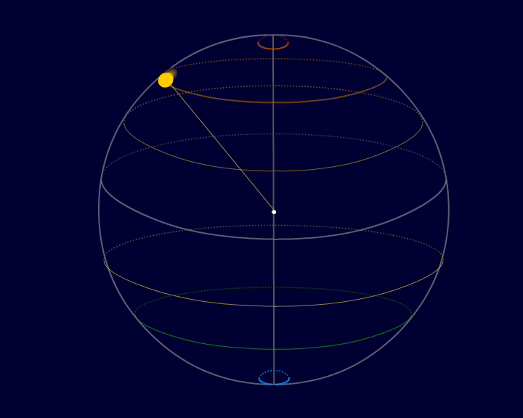
Quantum Instruction: The Computing Model
Quantum Instruction
Quantum Instructions manipulate the state of qubit
By rotating state vector in the Hilbert space
Notes:
To manipulate the state of qubit we can use quantum instructions. Which rotates the state vector from one point on the sphere to other point on the sphere.

Slide 32
Transformation: The Key to Computing
Problem
Problem
Quantum Algorithms
Algorithms
PL & Compilers
Compilers
Architecture
Quantum Architecture
Circuits
Quantum Interfaces
Devices/Technology
Quantum Devices
Electrons
Photons/Ions/Superconductor
My proposal focuses on architecture for quantum computer
Notes:
That’s why we want to do quantum architecture – to estimate what are the challenges and how w can make our systems more efficient and reliable

Slide 33
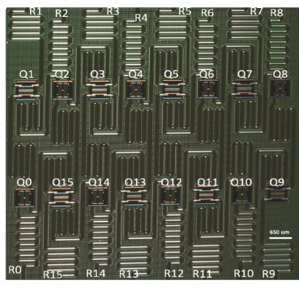
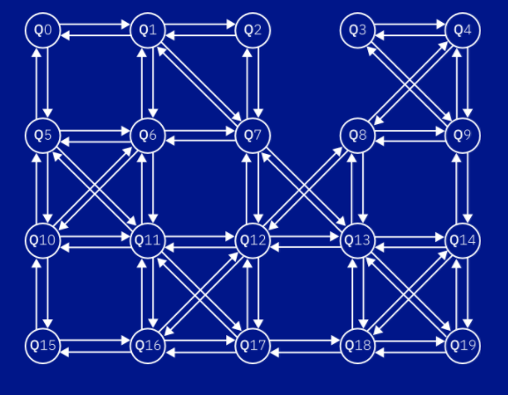
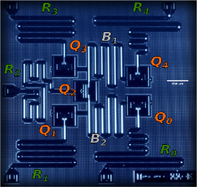
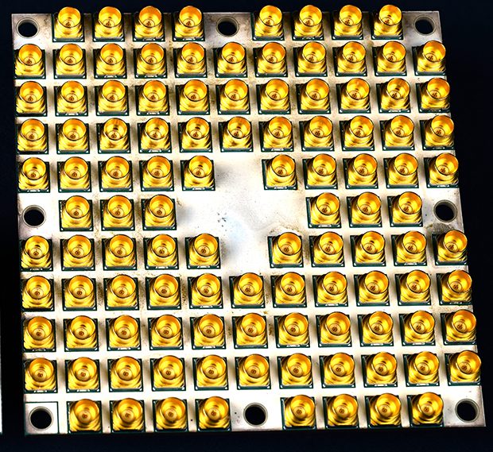
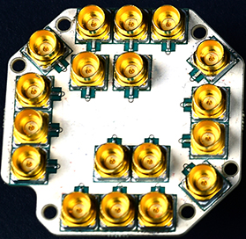
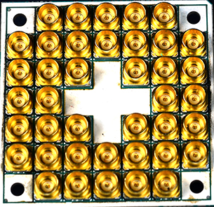
Existing Superconducting Qubit Chips
IBM
5 Qubits
16 Qubits
20 Qubits
Intel
7 Qubits
17 Qubits
50 Qubits
In this proposal, I will focus on superconducting qubit technology

Slide 34
Quantum Control Computer
Quantum Computer = Qubits + Control Computer
Control Computer -- manipulates the qubit states
Control Computer
Qubits
Control Computer -- Interface between Qubits & Programmer
Notes:
Control computer executes instructions on a quantum computer

Slide 35
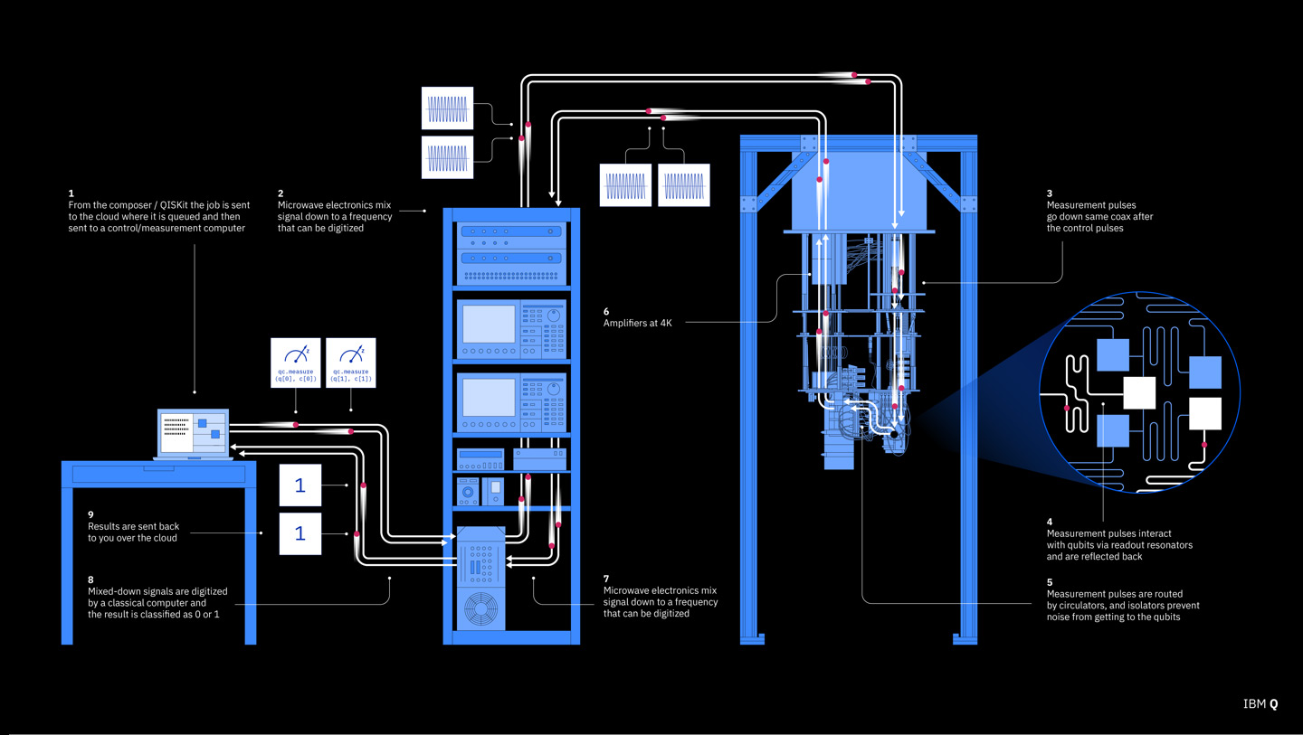
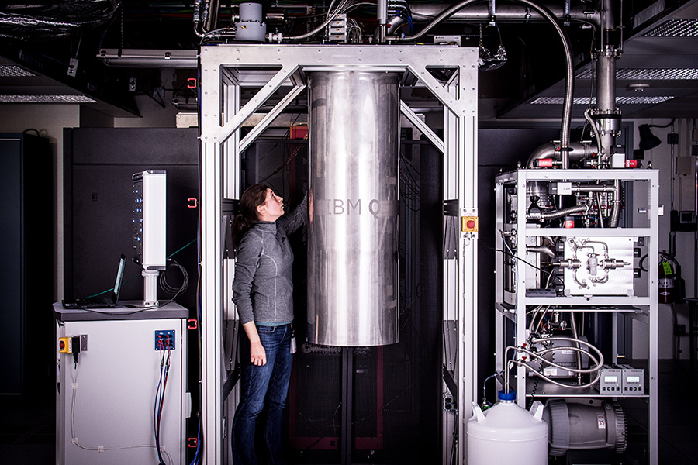
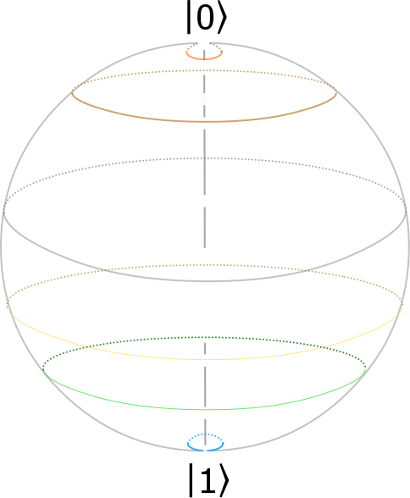
Existing Quantum Computers
Source: IBM Quantum Experience
Dilution Refrigerator
Dilution Refrigerator
Programmer
Qubits
Qubits
(20 mK)
Quantum Bit
20 mK
Quantum Chip
Ref: IBM Quantum Experience
Qubits require cryogenic operating temperature to minimize thermal noise
Control Processor

Slide 36
Quantum bits are fickle
Even at 20mK, qubits can lose state
1
0
Classical Bit
Quantum Bit
Need Error Correction to protect Quantum bits
Notes:
Brief mention of decoherence

Slide 37
Quantum Error Correction
Quantum Error Correction Code
Collection of Noisy
Physical Qubit Devices
Fault-Tolerant
Logical Qubit
Error Correction can enable Fault-tolerant Quantum Computers (FTQC)
QEC require 10 to 100 physical qubits to create fault-tolerant logical qubit

Slide 38
Quantum Error Correction is Expensive
Quantum Error Correction require 10 to 100 physical qubits to create fault-tolerant logical qubit
For near-term we may have to use Noisy Intermediate Scale Quantum Computers (NISQ)
10⁶
10⁵
10⁴
10³
10²
10¹
10⁰
FTQC
Number of demonstrated qubits
Noisy Intermediate Scale Quantum Computers
(NISQ)
2000
2010
2020
Future
Near term quantum computers will be noisy

Slide 39
Quantum Error Correction
Data Qubits
Ancilla
Qubits
Syndrome Generator
Syndrome Measurement
Fault-Tolerant
Logical Qubit
QECC is applied on all qubits continuously to preserve state
Notes:
1 min
Ancilla qubits
Entanglement
Diagram

Slide 40
Cryogenic Control Processor
Control Processor
4K
Control Processor
300K
Metal Wires
→ Thermal Leakage
Superconducting wires
→ Low Leakage
Qubits
20mK
20mK
Qubits
Cryogenic Control Processor is essential for scalable Quantum Computer
(Ref: Cryogenic Control Architecture for Large-Scale Quantum Computing by Hornibrook et. al)

Slide 41


Taming the Instruction Bandwidth of Quantum Computers
(MICRO – 50)
Swamit Tannu
Zach Myers
Prashant Nair
Douglas Carmean
Moinuddin Qureshi
Notes:
30 sec – cryogenic and quantum error correction

Slide 42
QECC aware Control Architecture
Uncorrectable Errors !!
Control Processor
Qubits
FTQC → QEC instruction supply needs to scale linearly with number of qubits

Slide 43
Programmable Quantum Error Correction
Different QECC Designed
New error correction codes → QECC needs to be programmable
Software managed QECC → Compiler inserts QECC instructions in regular instruction stream
Different Error Correction Designs
Surface
Code
Cost
Concatenation
Code
Error Rate
Programmable QEC is essential for leveraging trade-offs in QEC design
Notes:
QECC is embedded in the programming model

Slide 44
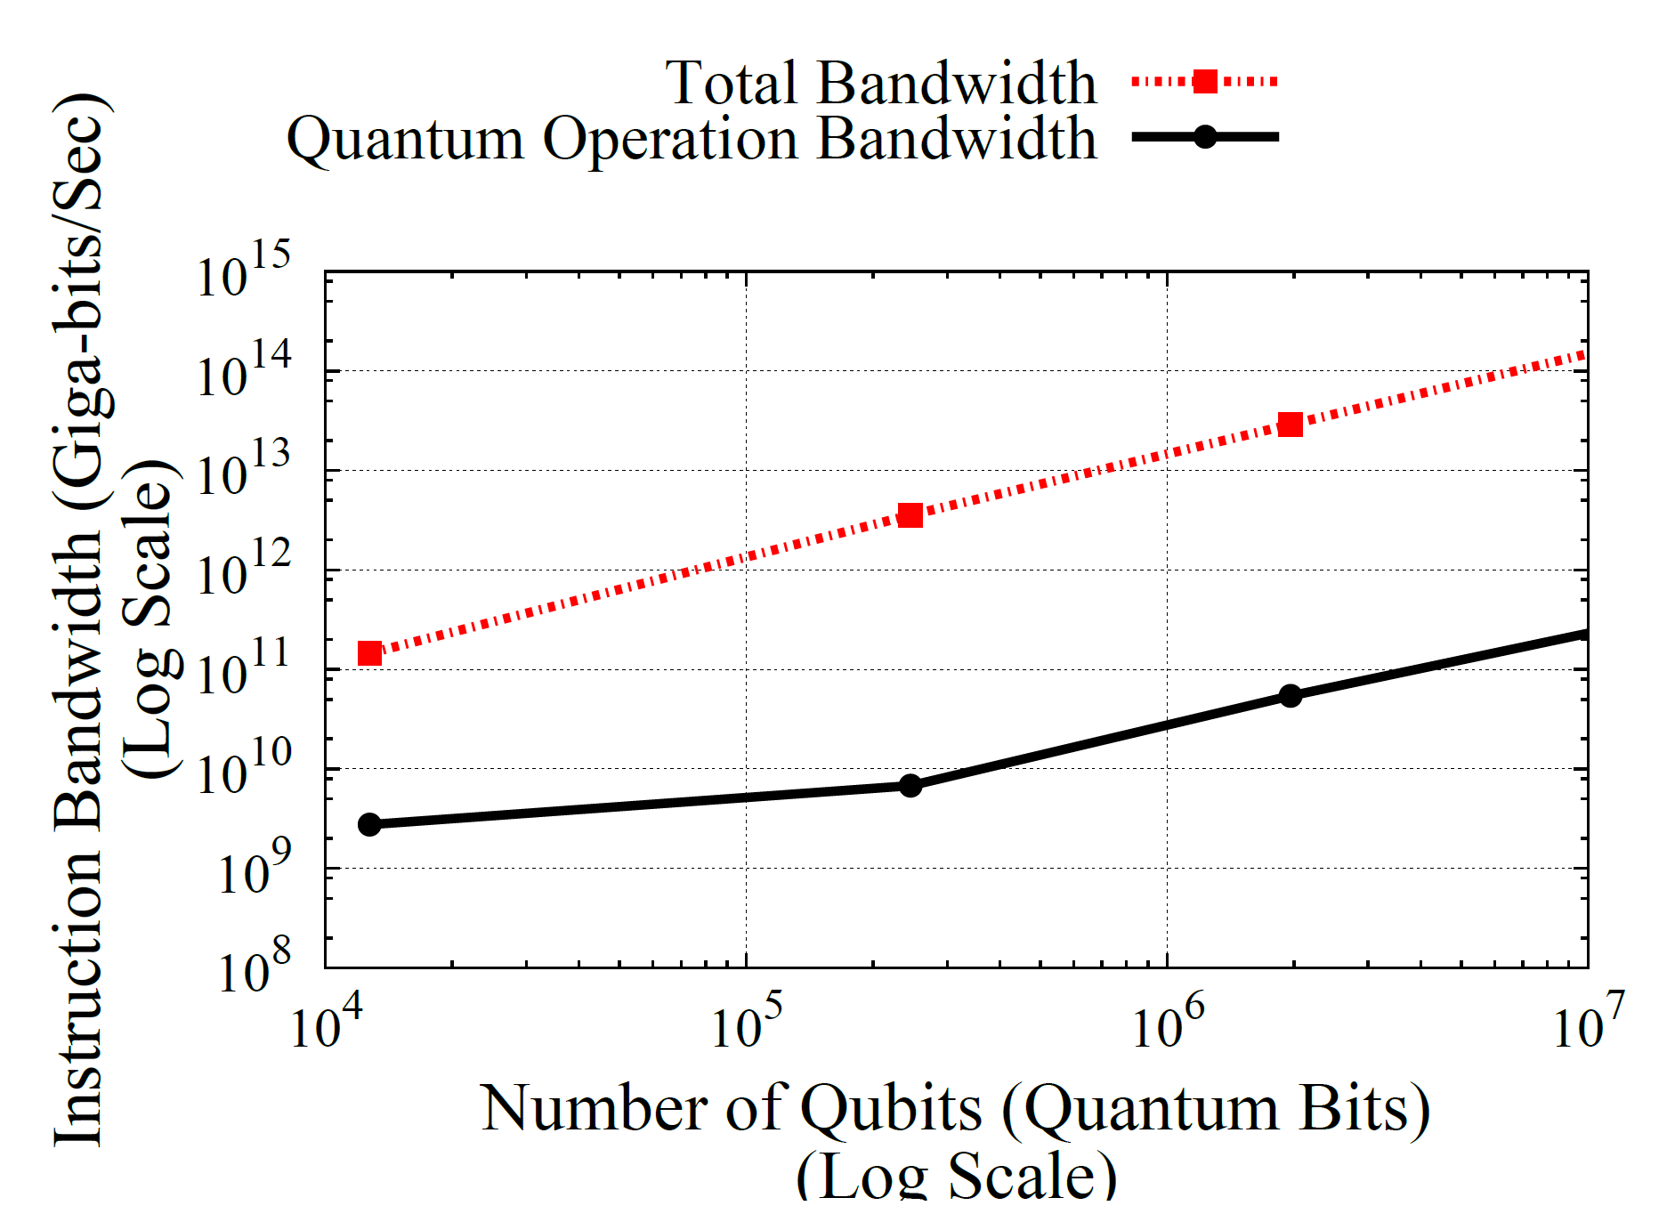

Problem: Instruction Bandwidth Bottleneck
Shor’s Algorithm
Can’t use i-cache -- delay in delivery of QECC instructions results in error
SW-QECC + no i-cache→ instruction bandwidth must scale linearly with number of qubits
Total Bandwidth
Non-QECC Bandwidth
1024 bit
QECC Bandwidth Bloat – 10,000X
Instruction Bandwidth (B/s)
Can’t use
i-cache
256 bit
128 bit
Number of Qubits
Notes:
Hook for detailed discussion
Add more results

Slide 45


Programmability
BW Efficiency
Software-Managed QECC
Hardcoded
QECC
Goal: To enable programmable Quantum Error Correction without bandwidth bloat

Slide 46
Insight
QECC can be executed independently without any global synchronization
QECC is simple enough to manage in hardware using programmable microcode

Slide 47
Quantum Error Correction Substrate (QuEST)
Master Controller
µcode engine continuously issues QECC µops
Master controller issues regular instructions. µcode Engine decodes it to µops
Control Processor
µ-Code
Engine
µ-Code
Engine
µ-Code
Engine
µ-Code
Engine
Qubits
QuEST alleviates instruction bandwidth by issuing QECC ops locally
Notes:
Make baseline clear by animating the baseline– master controller sends both QECC and regular instructions
Thi

Slide 48
QuEST -- Organization
Notes:
1.30 min

Slide 49
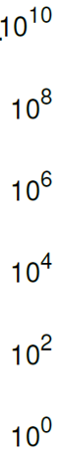
Evaluations
10⁷x
10⁵x
Reduction in Global
Instruction Bandwidth
QuEST reduces global bandwidth demand by orders of magnitude
Notes:
Why we get this benefit ?
Most of the instructions stem from QECC we handle QECC in microcode and that reduces the instruction bandwidth demand by several orders of magnitude. This graph shows Reduction in Global
Bandwidth demand on the y axis for quantum workloads including Shors algorithm.
On average Quest reduces instruction bandwidth demand by seven order of magnitude

Slide 50
Key Takeaway for QUEST
Programmability
BW Efficiency
Software-Managed QECC
Hardcoded
QECC
QuEST (µcode)

Slide 51
Scalable Organization

Slide 52
Cryogenic DRAM based Memory System for Scalable Quantum Computers: A feasibility study
(MEMSYS 2017)
Swamit Tannu
Douglas Carmean
Moinuddin Qureshi
Notes:
30 sec

Slide 53

Memory for Quantum Computers
Program Memory + Data Memory → Stores Quantum Executable , Data (~10s GB)
Memory must be kept at cryo temperature to avoid large thermal gradient
Josephson Junction technology works at 4K
→ Limited memory density (only few Mb)
Program Memory
Data Memory
Memory
Control Processor
Qubits
Quantum Computer
Quantum computers require substantial memory capacity at cryo temperature
Notes:
Quantum computer can be imagined as the conventional computer connected to the quantum bits or qubits . The conventional computer known as control processor which can manipulate the state of the qubits and act as an interface between the programmer and the qubits. Control processor requires memory to store the quantum program and store the quantum and classical variables. Quantum programs are large and require memory capacity of few 10s of GBs. On the other hand data memory is required to support quantum error correction which is fundamental to build a large scale quantum computers. Quantum error correction is necessary because qubits are fickle

Slide 54
Does commodity DRAM work at cryogenic temperatures ?
Goal: To characterize a DRAM at cryogenic temperature to understand the functionality and error patterns
Notes:
Skip THIS AND MOVE IT TO BACKUP

Slide 55
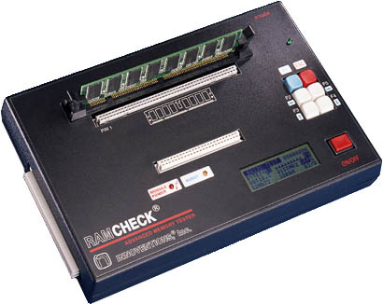
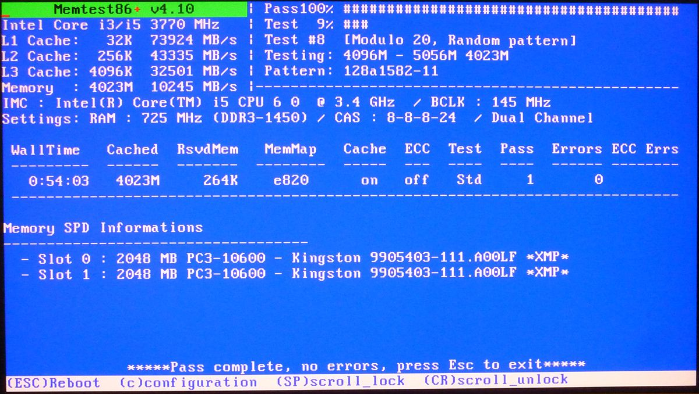
How to Test DRAM at Cryogenic Temperature?
Conventional memory testing → Memtest86 running on host, dedicated memory testers
Host machines or memory testers do not work at cryogenic temperatures
Need mechanism to reduce DIMM temperature without affecting tester

Slide 56
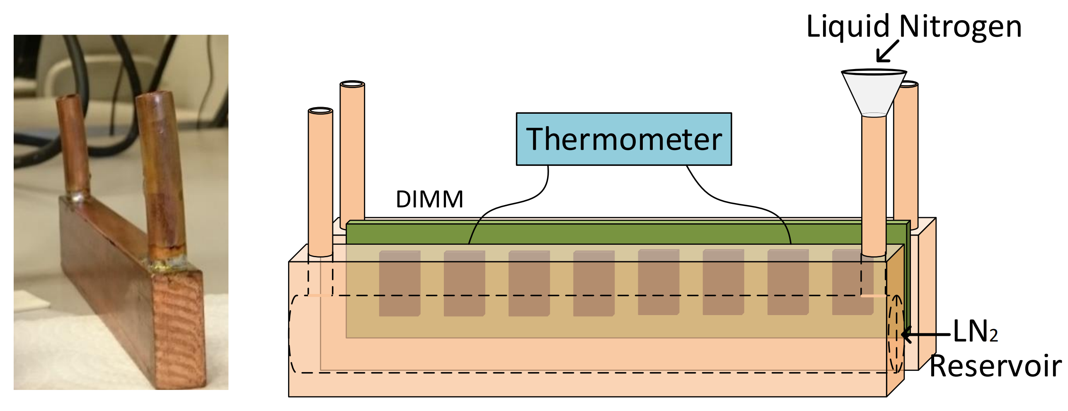
Isolated Cooling of DIMM
Need cryogenic coolant → Liquid Nitrogen (boils at 77K)
Need isolated cooling of DIMMs → Compact cryogenic heatsink
DIMM is sandwiched between two heatsinks and can be cooled down to 80K
Compact heatsink with Liquid Nitrogen provides isolated cooling of a DIMM

Slide 57
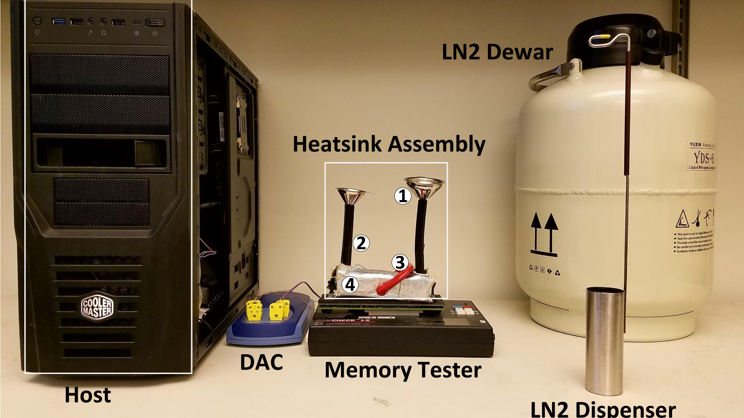
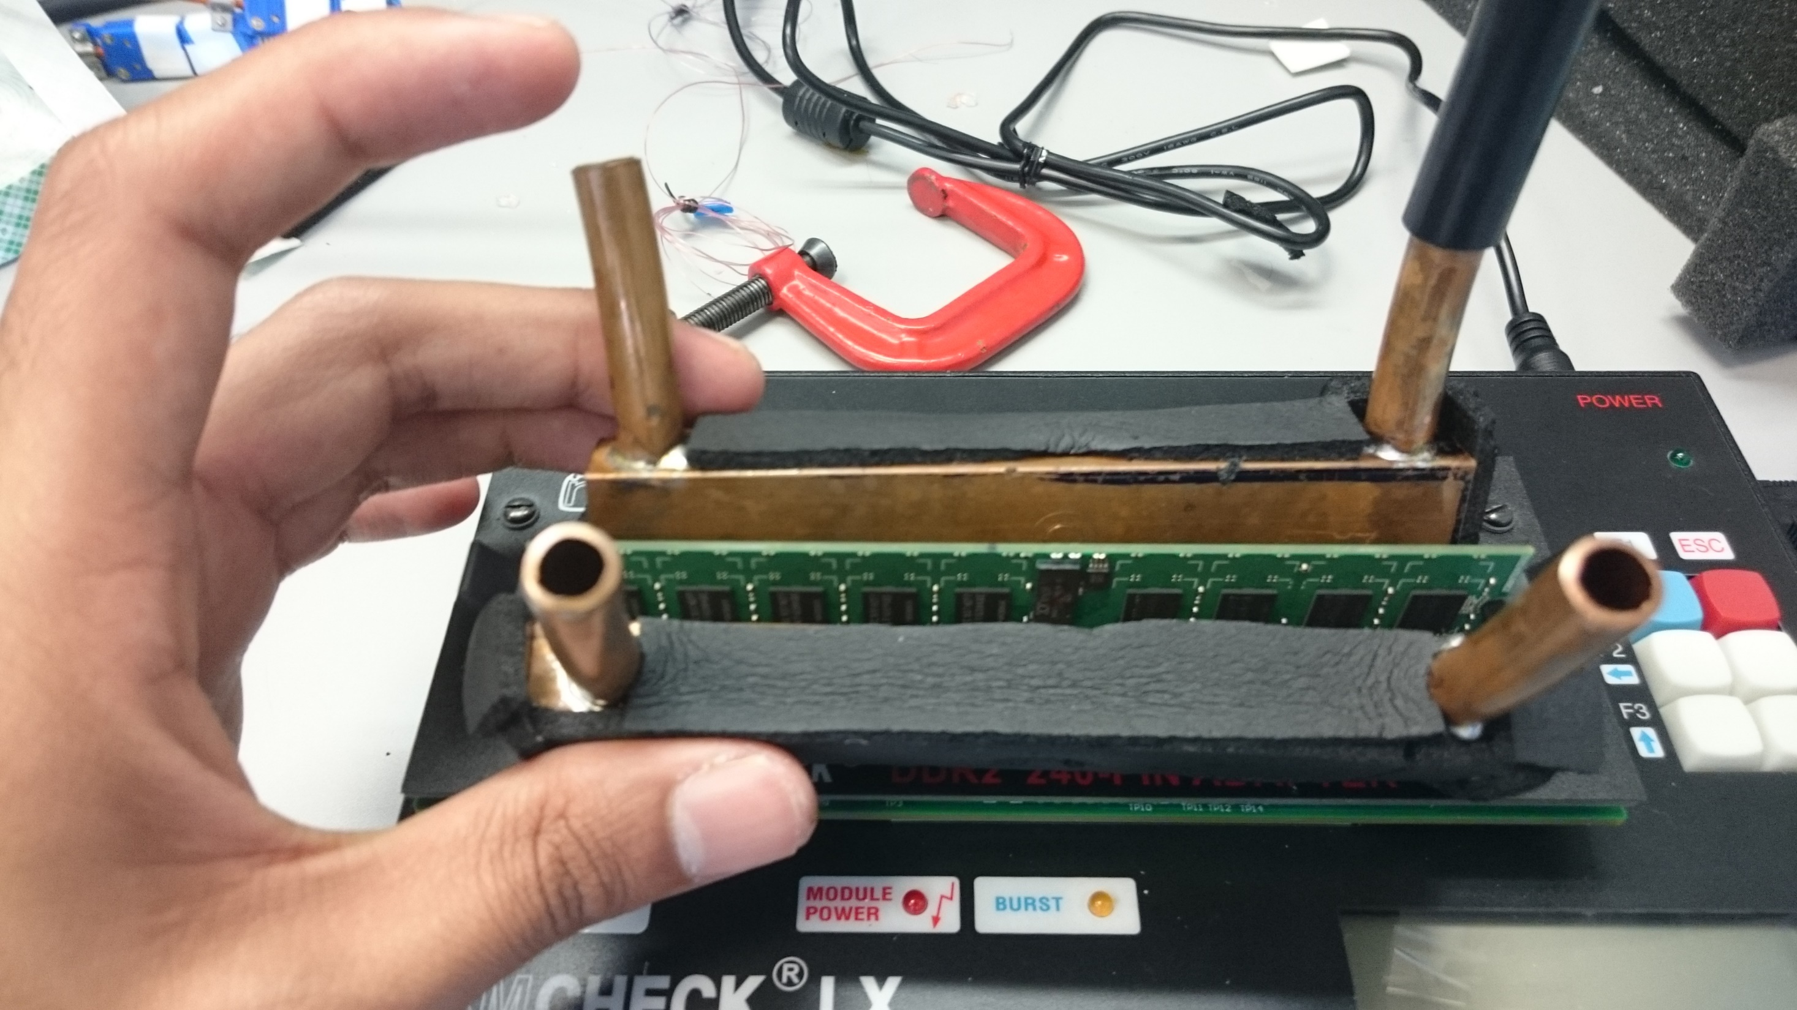

Slide 58
Minimum Operational Temperature for DIMMs
DIMM Failure!
Minimum Operating
Temperature (K)
18% DIMMs are functional below 90K
Notes:
Title
Animation

Slide 59
Chip Failures
8%
92%
92% of chips worked at 90K — Pick cryogenic tolerant chips

Slide 60
Fault Granularity
Single bit errors → Uncorrelated faults
Linear codes (SECDED, BCH) are still effective
Single bit fault | 99.985%
Double bit fault | 0.015%
Uncorrelated faults → Conventional ECC can be effective for Cryo DRAM

Slide 61
Cold DRAM – Take Away
Quantum computers need dense memory at low temperature
Does DRAM Work at cryogenic temperature?
Experiments show → most commodity DRAM chips work at 90K
Error patterns are amenable to existing fault tolerance techniques

Slide 62
Variation Aware Policies for NISQ-Era Quantum Computers
Swamit Tannu
Moinuddin Qureshi
(under review)
arXiv:1805.10224v1
Notes:
30 sec

Slide 63
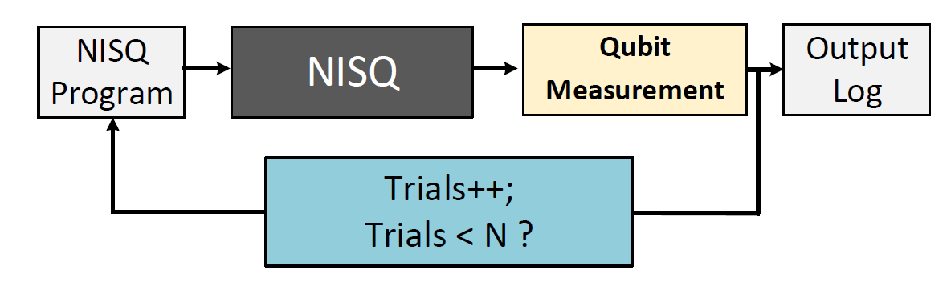
Programming Model for NISQ
Execute instructions
Read qubit states
1
2
Repeat
Probability of successful trial (PST) is the key metric for NISQ machines
Notes:
NISQ machines do not have any protection against errors
NISQ programs also come in different flavors, there are programs which give answer in one trial
Whereas there are programs which require N trials
If ideal quantum computer that has no errors changes the trails substantially. Natutrally if you have errors then you need

Slide 64
Data movement on quantum computer
Q1
cnot q[1], q[2];
A
B
Q3
C
Q2
swap q[2], q[3];
cnot q[1], q[2];
D
E
SWAP operations can be used to move data on a quantum computer

Slide 65
Qubit Allocation Problem
#Program with X:
Mapping X
cnot q[0], q[1];
cnot q[0], q[2];
cnot q[0], q[3];
cnot q[0], q[4];
Mapping-X
Mapping-Y
#NISQ Program:
cnot q[0], q[1];
swap q[0], q[2];
cnot q[0], q[2];
cnot q[0], q[3];
cnot q[0], q[4];
A → q [0]
B → q [1]
C → q [2]
D → q [3]
E → q [4]
0
1
1
A
B
2
2
C
0
3
4
3
4
D
E
Mapping Y
cnot q[0], q[1];
cnot q[0], q[2];
cnot q[0], q[3];
cnot q[0], q[4];
#NISQ with Y:
A → q [2]
B → q [1]
C → q [0]
D → q [3]
E → q [4]
Mapping | Total SWAPs
X | 1
Y
Mapping | Total SWAPs
X | 1
Y | 0
Qubit mapping has large impact on no. of swaps in NISQ applications

Slide 66
Cost of performing a SWAP operation
SWAP operations are unreliable
Extra SWAPs reduce reliability of applications significantly
Existing allocation policy [1] minimize number of SWAPs
[1] Alwin Zulehner, Alexandru Paler, and Robert Wille. Efficient mapping of quantum circuits to the ibm qx architectures (arXiv:1712.04722, 2017).
But allocation policy [1] use uniform SWAP cost

Slide 67
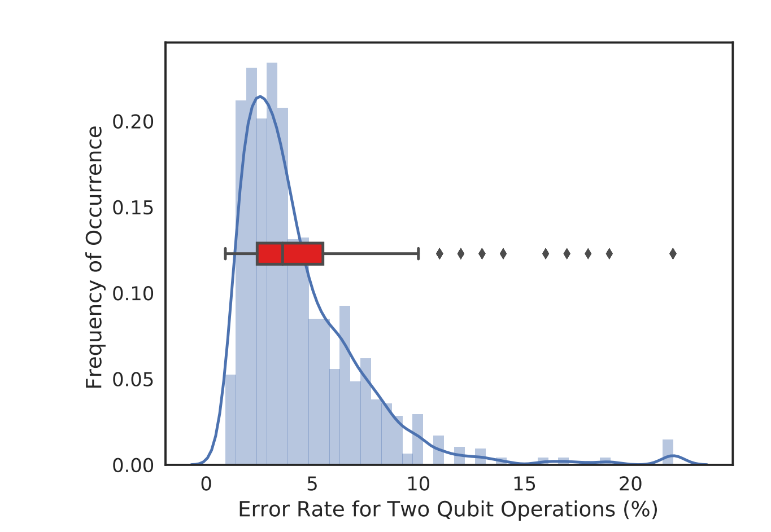
Not all quantum links and qubits are created equal!
Link error rate over 52 days for 76 quantum links in IBM-Q20 machine
Characterization of IBM-Q20 show a heavy tail for link error rate

Slide 68
Variation in Link Error Rates on IBM-Q20
Average link error rate for 76 links in IBM-Q20 machine
All links are not created equal, IBMQ20 has significantly weak links

Slide 69
Goal: To improve reliability of NISQ by designing variation-aware compiler policies
Notes:
Skip THIS AND MOVE IT TO BACKUP

Slide 70
Qubit Movement Problem
Q1
Q1
Q3
Q3
Q1
Q1
Q3
Q3

Slide 71
Variation-aware Qubit Movement (VQM)
Data Movement Path | Probability of Success
A-B-C-F | 0.8*0.8*0.6 = 0.384
Data Movement Path | Probability of Success
A-B-C-F | 0.8*0.8*0.6 = 0.384
A-D-E-F | 0.8*0.7*0.6 = 0.336
Data Movement Path | Probability of Success
A-B-C-F | 0.8*0.8*0.6 = 0.384
A-D-E-F | 0.8*0.7*0.6 = 0.336
A-D-C-F | 0.8*0.9*0.8 = 0.576
0.8
0.7
Q1
0.8
0.9
0.6
Q3
0.6
0.8
cnot q[1], q[3]
Chose a sequence of swaps that maximizes the reliability

Slide 72
Variation-aware Qubit Allocation (VQA)
cnot q[1], q[2];
cnot q[2], q[3];
cnot q[3], q[4];
Q2
#NISQ Program:
0.8
0.7
Q1
0.8
0.9
0.6
0.6
0.8
Q4
Q3
Q4
PST1 = 0.43
PST2 = 0.57
Chose qubits that maximizes the reliability

Slide 73
VQA and VQM Design
To enable VQA and VQM we use reliability-aware cost functions
For both VQM and VQA all the decisions are made using a greedy heuristic and they can be used with any existing allocation policies

Slide 74
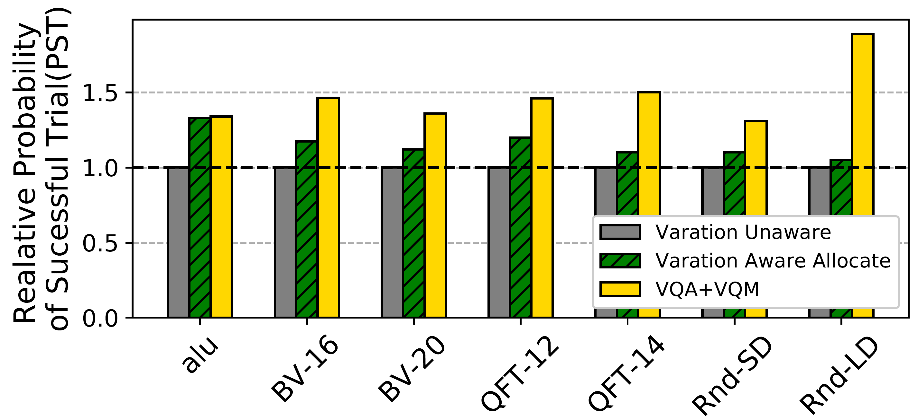
Impact of VQA+VQM on PST
VQA+VQM improves PST up to 1.83x over variation-unaware baseline
Notes:
We build a simulator to evaluate the efficien

Slide 75
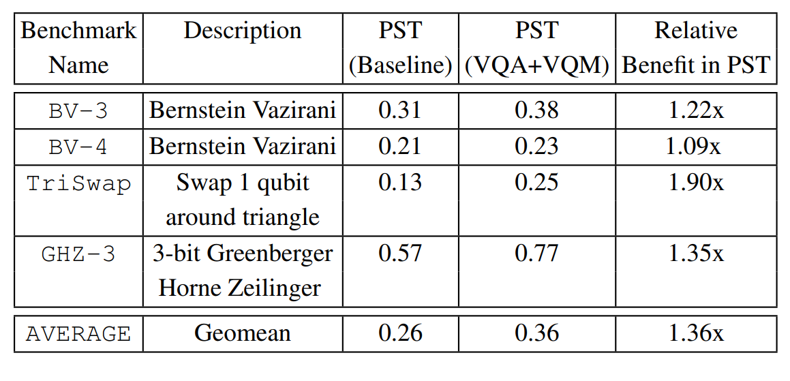
Evaluations on IBM-Q5
Notes:
We also test VQA and VQM on real machine

Slide 76
Conclusion
Existing superconducting qubits suffer large variation in error-rate
Variation in error-rate can deteriorate the reliability of NISQ applications
Variation-aware policies for qubit allocation and movement can improve reliability by minimizing use of links that are significantly weak

